Slide 1

SAY HELLO TO
Liane Stevenson @webdevelopwolf www.webdevelopwolf.com

Slide 2
INTRODUCTION
Lets get on the road…

Slide 3
WHAT DID WE DO LAST TIME?
Why design our apps?
Stages of app design
Benefits of app design

Slide 4
WHAT ARE WE DOING TODAY?
Finding out what Ionic is and does
Starting our first Ionic Mobile App
Looking at how navigation works in Ionic
Creating a skeleton app

Slide 5
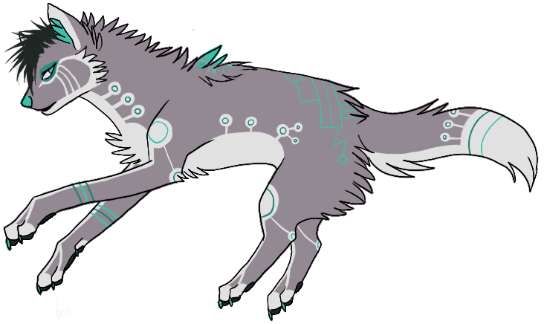
Need help?
Github:
http://www.github.com/webdevelopwolf/training
Twitter:
http://www.twitter.com/webdevelopwolf
Facebook:
http://www.facebook.com/webdevwolf

Slide 6
WHY IONIC?
It’s not electric, it’s supercharged!

Slide 7
What is Ionic?
“Ionic is an HTML5 mobile app development framework targeted at building hybrid mobile apps.”
From Ionic team’s documentation

Slide 8




Cool, but what’s a hybrid app?
To understand what a hybrid app is, we need to go back in time to before Ionic was even heard of:
If we wanted an application on iOS, Android and Windows, we had to build three apps in three languages (Objective C, PHP or C#).
Then Cordova came along and somewhat saved us all. Cordova creates a bridge between the three platforms using JavaScript, creating our hybrid app. Huzzah!
So now we can make one application back-end, but if we want our apps to have the same look and feel as our device we still need three different apps with three different looks.

Slide 9
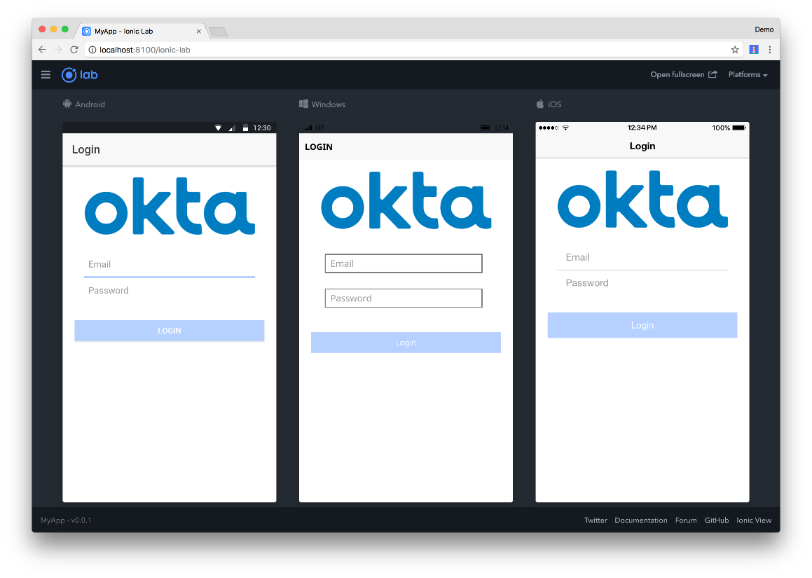
That’s where Ionic comes in…
Ionic will detect the device it’s running on and style accordingly. Meaning we can build, maintain and deploy just one application with many faces.
Other Ionic benefits include:
Built on top of Angular and TypeScript
Powerful Navigation Stack
Intelligent Build System
Unrivalled Performance

Slide 10
GETTING STARTED
Let’s jump in – wheeeeeeee!

Slide 11


Installing Ionic
First of all, to install Ionic, we need to have NodeJS installed
https://nodejs.org/en/
Download and run the current version
Open Command Prompt in windows (or Terminal in MacBook)
npm install –g ionic cordova
That’s all there is to it! What we just installed is called a Command Line Interface or CLI for short

Slide 12

Starting a new project
This one is really easy folks, we can start new Ionic project in two very simple steps
Open Windows CMD or MacBook Terminal
Type in, ionic start [project name] tabs
Hit enter and that’s it!
One thing to note however…it will place your app in the folder your CMD is in at the time the command is run.
To change this, type cd C:\Folder BEFORE, running your ionic start command
You can see a full list of Ionic commands by simply typing ionic in the command line

Slide 13
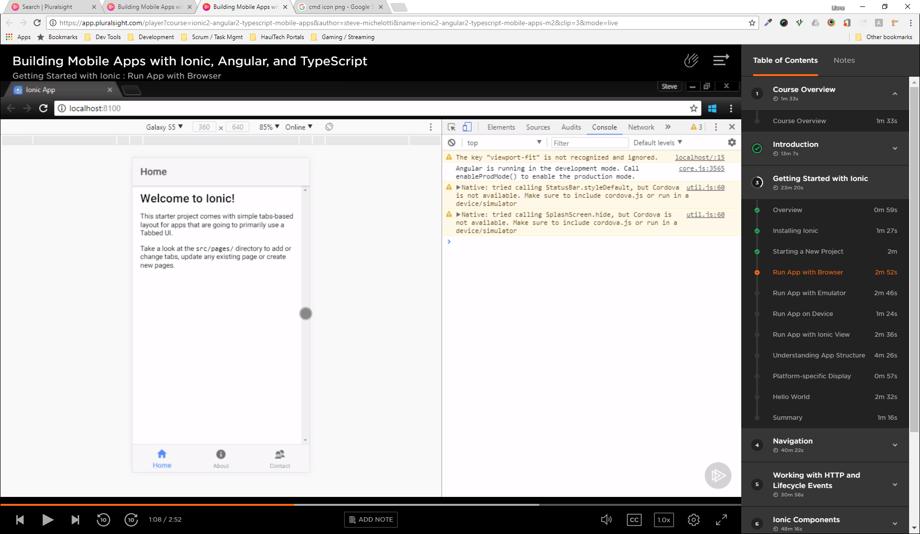
Run application in the browser
Now we have our basic mobile application we can already see what it looks like using ionic serve
This opens up your default browser to http://localhost:0000 and displays your mobile app, but at this point it’s huge!
Don’t worry, if we press F12 and click the Mobile View Toggle we can see the app as we would on a mobile device. We can even switch between devices.

Slide 14
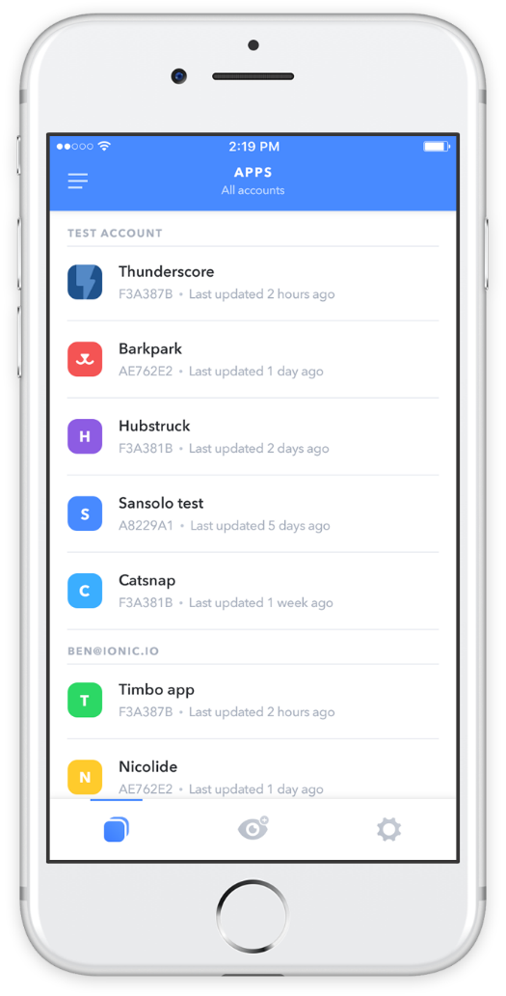
Run application on a mobile
There’s going to be a time when you need to run your application on a mobile itself for things like:
Using the camera
Scanning QR or Barcodes
Accessing anything else that uses features native to the phones operating system
We can find out how to do this at: https://ionicframework.com/pro/view

Slide 15

Argh! What’s all these files and folders?
Even such a small mobile app has a large folder structure, but don’t panic, it’s not as confusing as it first seems.
The src folder is like ‘O Mally the Alley Cat…it’s where it’s all at. This is the folder we’re going to live in when developing our app.
The whole app runs from a single page, index.html, using the <ion-app> tag as a container for our application that we see in the browser.
The app folder is our starting point and contains all the configuration for our app, including:
Sections (or modules)
Plug-ins
Services
Etc.
The pages folder is each section of our app and each section has three parts:
HTML
CSS (or SCSS)
TypeScript (.ts)
The www folder contains very little at the moment, but when our app is complete and we build it, it will be stored here in a web friendly version.
Any assets we use in our app such as images should be copied in the assets folder

Slide 16
NAVIGATION
Bring your map and be prepared to ask for directions!

Slide 17

The Navigation Stack
Without us even realising it, Ionic is creating a stack of pages as we navigate around the app
Newly opened pages get pushed onto the stack and when we hit the back button, the last page is popped off the stack
Most applications will only have one stack, however Ionic does support more than one stack

Slide 18

Creating an app skeleton
This is where our planning comes in handy. Remember how we marked out our pages in Storyboards? That reminds us what we need to include in the app. This helps us build a ‘skeleton’ app so we can see how we’re going to move around. First of all we need some pages. We do this with the following command in Ionic:
Ionic generate page [name] –no-module
We do this for each page we want to create in our application and add these to our module declaration. Next we’ll put some links in…

Slide 19
Using The Navigation Stack
We add and remove items to and from the navigation stack with the help of the NavController.
This is pre-imported into pages generated in Ionic using the command we ran previously
We create our own instance of the NavController and push the page we want to navigate to onto the stack, like so…
You’ll notice when we test this, we already have a back button that automatically returns us to the home page that we started on. To mimic this behaviour we can pop the current page off the stack in a similar way to how we pushed the page onto the stack

Slide 20
WHAT DID WE LEARN THIS TIME?
Finding out what Ionic is and does
Starting our first Ionic Mobile App
Looking at how navigation works in Ionic
Creating a skeleton app

Slide 21
THIS TIME’S CHALLENGE!
Build a menu screen that links to all of the pages you have created
For bonus points, expand your application:
Create a new page
Declare this page in the app config
Link to it from your menu

Slide 22
Need help?
Github:
http://www.github.com/webdevelopwolf/training
Twitter:
http://www.twitter.com/webdevelopwolf
Facebook:
http://www.facebook.com/webdevwolf

Slide 23

NEXT SECTION…
We’re going to be putting together a slick-looking slide-in navigation menu in Ionic and starting to look at putting a few Ionic components in our app such as lists, tabs and more! And we’ll be styling our app along the way! ☺

